Slide 1
JAC444 - Lecture 5
Threads
Segment 2 - Synchronization

Slide 2
Threads
In this section you will be learning about:
Synchronization
Synchronized Methods
Deadlock
Starvation and Livelock

Slide 3
Synchronization Concepts
Synchronization is built around the concept known as the intrinsic lock
본질적인
Every object has an intrinsic lock associated with it
A thread that needs access to an object's fields has to acquire the object's intrinsic lock
A thread has to release the intrinsic lock when it's done with an object
A thread is said to own the intrinsic lock since acquires until releases the object's intrinsic lock
Any other thread will block when it attempts to acquire the object's intrinsic lock, if the lock is owned by another thread

Slide 4
Why Synchronization?
The synchronization is mainly used to
To prevent thread interference.
To prevent consistency problem.
Types of Synchronization
There are two types of synchronization
Process Synchronization
Thread Synchronization

Slide 5
Thread Synchronization
There are two types of thread synchronization mutual exclusive and inter-thread communication.
Mutual Exclusive
Synchronized method.
Synchronized block.
static synchronization.
Cooperation (Inter-thread communication in java)

Slide 6
Mutual Exclusive
Mutual Exclusive helps keep threads from interfering with one another while sharing data. This can be done by three ways in java:
by synchronized method
by synchronized block
by static synchronization

Slide 7
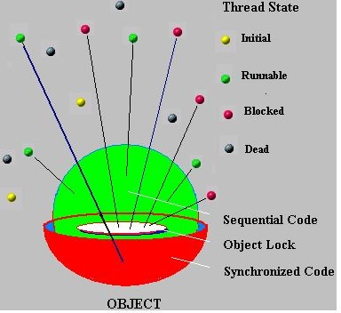
Thread State and Intrinsic Lock
Unsynchronized Code
Synchronized Code
Initial
Runnable
Blocked
Dead
Object Intrinsic Lock
Jordan Anastasiade – Java Programming Language Course 5

Slide 8
Synchronized Methods
When a thread invokes a synchronized method, it automatically acquires the intrinsic lock for that method's object
In a synchronized method, the thread releases the acquired lock when the method returns
class X extends Thread {
...
synchronized void method(...) {
...
return;
}
public static void main(...) { Thread t = new X(); t.method();
}
}
Intrinsic Lock

Slide 9
Class Table{
void printTable(int n){//method not synchronized
for(int i=1;i<=5;i++){
System.out.println(n*i);
try{
Thread.sleep(400);
}catch(Exception e){System.out.println(e);}
}
}
}
class MyThread1 extends Thread{
Table t;
MyThread1(Table t){
this.t=t;
}
public void run(){
t.printTable(5);
}
}
class MyThread2 extends Thread{
Table t;
MyThread2(Table t){
this.t=t;
}
public void run(){
t.printTable(100);
}
}
class TestSynchronization1{
public static void main(String args[]){
Table obj = new Table();//only one object
MyThread1 t1=new MyThread1(obj);
MyThread2 t2=new MyThread2(obj);
t1.start();
t2.start();
}
}
Output:
5
100
10
200
15
300
20
400
25
500
Inconsistent

Slide 10
Class Table{
synchronized void printTable(int n){
//method synchronized
for(int i=1;i<=5;i++){
System.out.println(n*i);
try{
Thread.sleep(400);
}catch(Exception e){System.out.println(e);}
}
}
}
class MyThread1 extends Thread{
Table t;
MyThread1(Table t){
this.t=t;
}
public void run(){
t.printTable(5);
}
}
class MyThread2 extends Thread{
Table t;
MyThread2(Table t){
this.t=t;
}
public void run(){
t.printTable(100);
}
}
class TestSynchronization1{
public static void main(String args[]){
Table obj = new Table();//only one object
MyThread1 t1=new MyThread1(obj);
MyThread2 t2=new MyThread2(obj);
t1.start();
t2.start();
}
}
Output:
5
10
15
20
25
100
200
300
400
500

Slide 11
Synchronized Block
Synchronized statements must specify the object that provides the intrinsic lock
In a synchronized statements , the thread releases the acquired lock when the last statement is executed
Synchronized block is used to lock an object for any shared resource.
Scope of synchronized block is smaller than the method.
public void addName(String studentName) { synchronized(this) {
lastName = studentName; nameCount++;
}
studentList.add(studentName);
}
Intrinsic Lock

Slide 12
Example Synchronized Method
public class SynThread implements Runnable { private String holdA = "This is ";
private int[] holdB = {1,2,3,4,5,6,7,8,9,10};
//without synchronized keyword public void run() {
for(int w = 0; w < 10; w++) { System.out.println(holdA + holdB[w] + ".");
}
}
public static void main(String args[]) { SynThread z = new SynThread();
new Thread(z).start(); new Thread(z).start();
}
}
Run this code twice: 1. as is, and 2. add synchronized keyword to run method. Can you see the difference?

Slide 13
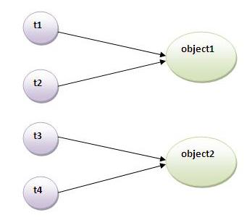
Static Synchronization
If you make any static method as synchronized, the lock will be on the class not on object.
Suppose there are two objects of a shared class(e.g. Table) named object1 and object2.
In case of synchronized method and synchronized block there cannot be interference between t1 and t2 or t3 and t4 because t1 and t2 both refers to a common object that have a single lock.
But there can be interference between t1 and t3
or t2 and t4 because t1 acquires another lock and t3 acquires another lock.
I want no interference between t1 and t3 or t2 and t4.
Static synchronization solves this problem.

Slide 14
class Table{
synchronized static void printTable(int n){
for(int i=1;i<=10;i++){
System.out.println(n*i);
try{
Thread.sleep(400);
}catch(Exception e){}
}
}
}
class MyThread1 extends Thread{
public void run(){
Table.printTable(1);
}
}
class MyThread2 extends Thread{
public void run(){
Table.printTable(10);
}
}
Output:
1
2
3
…
10
10
20
30
…
100
100
200
300
….
1000
1000
2000
3000
…..
10000
class MyThread3 extends Thread{
public void run(){
Table.printTable(100);
}
}
class MyThread4 extends Thread{
public void run(){
Table.printTable(1000);
}
}
public class TestSynchronization4{
public static void main(String t[]){
MyThread1 t1=new MyThread1();
MyThread2 t2=new MyThread2();
MyThread3 t3=new MyThread3();
MyThread4 t4=new MyThread4();
t1.start();
t2.start();
t3.start();
t4.start();
}
}

Slide 15
Liveness
Liveness is the property of a concurrent application to execute in a timely manner.
Liveness Problems:
Deadlock
Deadlock occurs when multiple threads need the same locks but obtain them in different order
Starvation
Starvation occurs when a thread is unable to gain regular access to shared resources and is unable

Slide 16
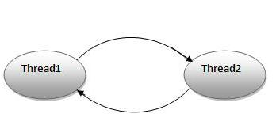
Deadlock Example
The threads t1 and t2 are blocked forever, waiting for each other - this problem is defined as being a deadlock
Jordan Anastasiade – Java Programming Language Course 10

Slide 17
public class TestDeadlockExample1 {
public static void main(String[] args) {
final String resource1 = “Some Name";
final String resource2 = “Other Name";
// t1 tries to lock resource1 then resource2
Thread t1 = new Thread() {
public void run() {
synchronized (resource1) {
System.out.println("Thread 1: locked resource 1");
try { Thread.sleep(100);} catch (Exception e) {}
synchronized (resource2) {
System.out.println("Thread 1: locked resource 2");
}
}
}
};
// t2 tries to lock resource2 then resource1
Thread t2 = new Thread() {
public void run() {
synchronized (resource2) {
System.out.println("Thread 2:
locked resource 2");
try { Thread.sleep(100);}
catch (Exception e) {}
synchronized (resource1) {
System.out.println("Thread 2:
locked resource 1");
}
}
}
};
t1.start();
t2.start();
}
}
Output: Thread 1: locked resource 1
Thread 2: locked resource 2

